Slide 1
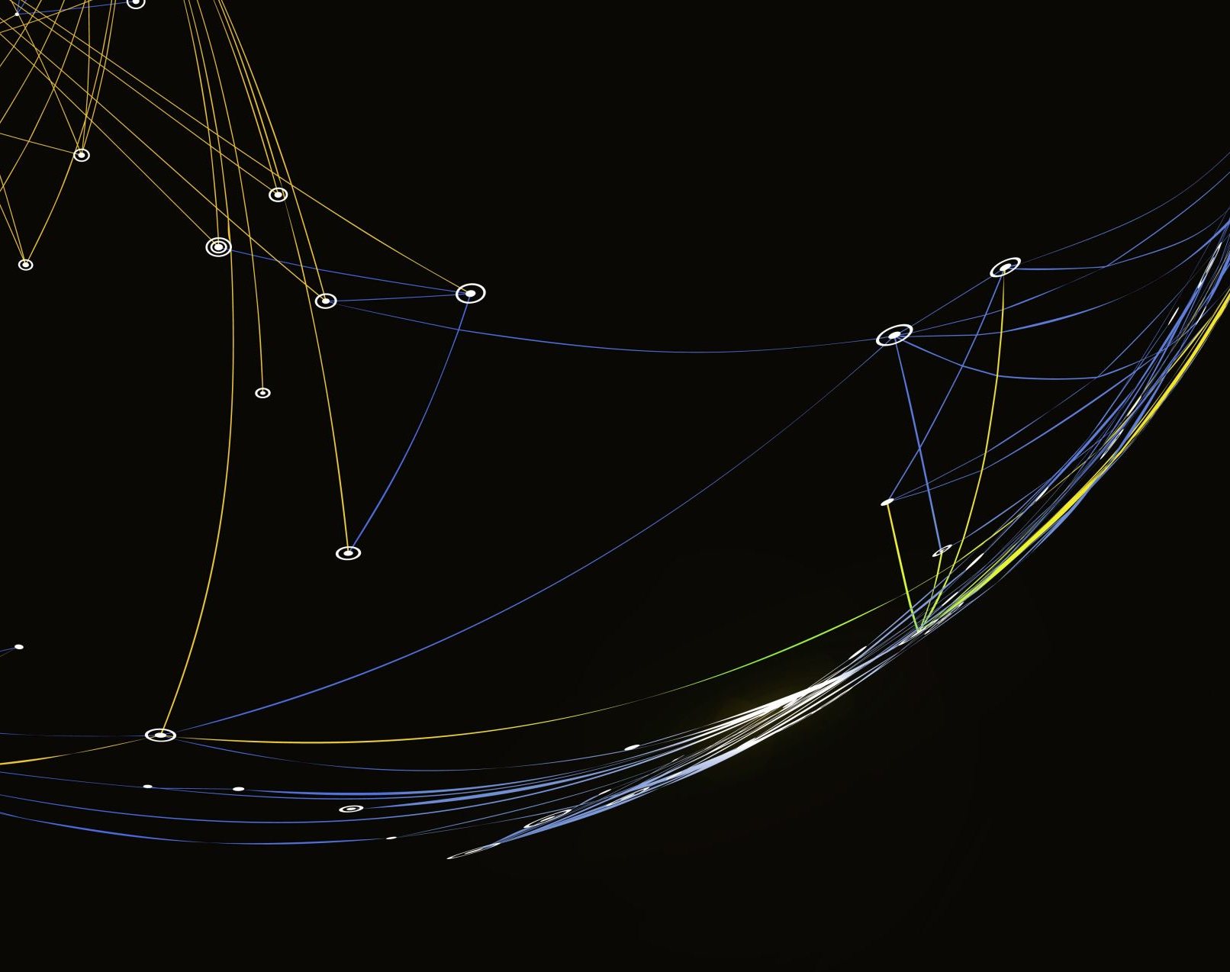
Interactive Audio Development for General Wellbeing
By Matt Simpson

Slide 2
Introducing the Project

Slide 3
Why?

Slide 4
Project Significance

Slide 5
Mental Health Over Recent Years

Slide 6
Mobile Technology and Apple

Slide 7
Apps for Mental Health

Slide 8
My Project’s Goals

Slide 9
The Plan

Slide 10
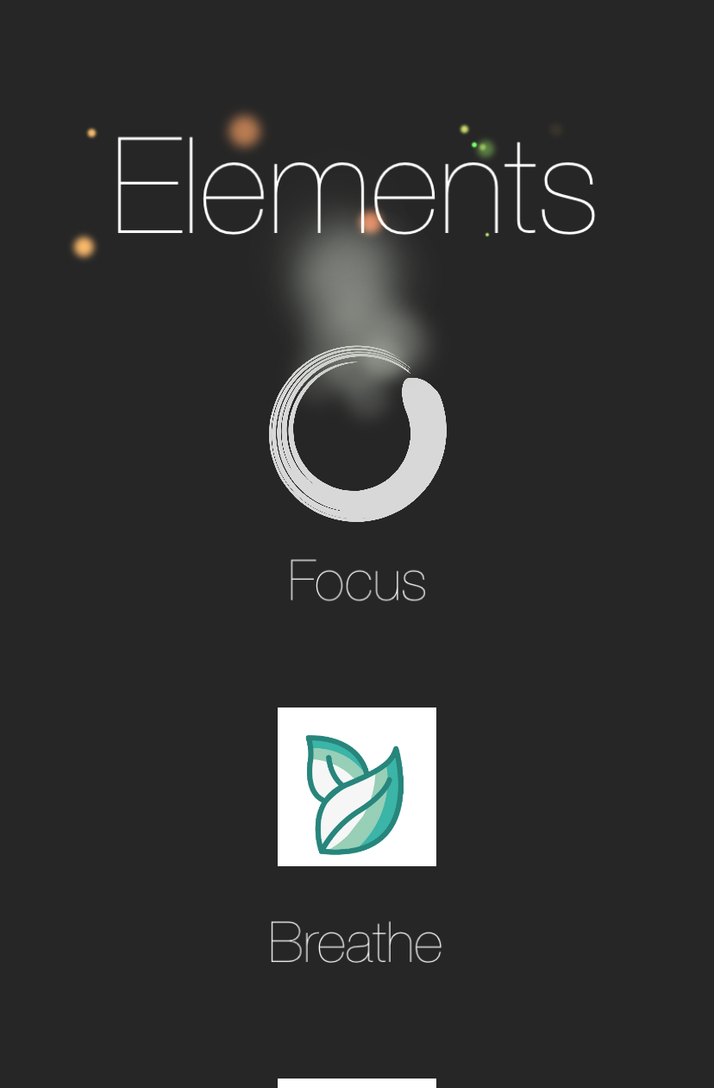
Current Progress & Results

Slide 11
Plan Moving Forward

Slide 12
Future Work

Slide 13
Beyond The Project

Slide 14

Thank You!
Get in touch: ms2071@york.ac.uk

